Slide 1
Unit Root Testing: History and Modern Applications
IAA September 2020
David A. Dickey – NC State University
Thanks to my sponsors:
State Retirement System & Social Security Administration

Slide 2


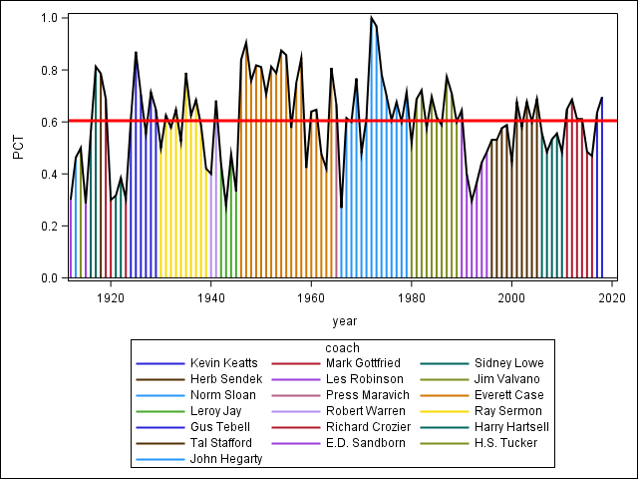
Winning
Percentages
1912-13
2017-18

Slide 3
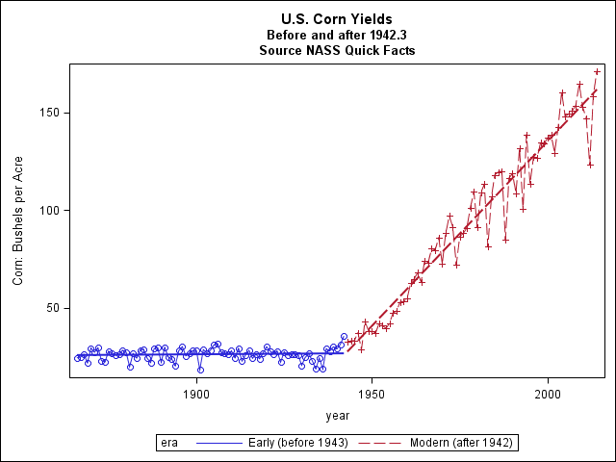


Corn Yields (BPA) Natl. Ag. Stat. Serv.
2014
1942
1866

Slide 4
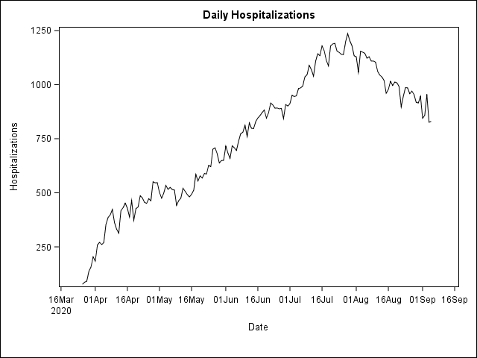


Slide 5
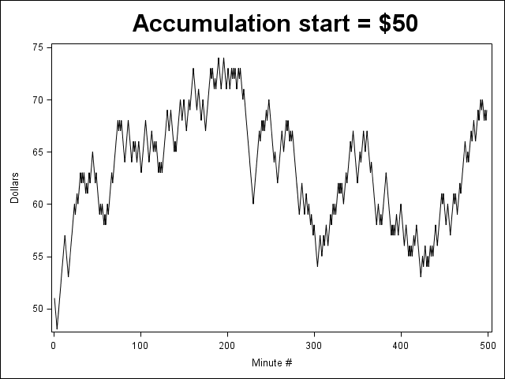
Stock price per minute for Unit Roots Inc.*

Slide 6
Basic Model:
Y_{t}− f(t) = ρ(Y_{t-1}− f(t−1))+e_{t}
Y_{t}− μ = ρ(Y_{t-1} − μ)+e_{t}
H₀:ρ=1
Y_{t}-μ = Y_{t-1}- μ + e_{t}
then Y_{t}= Y_{t-1}+e_{t} (random walk)

Slide 7
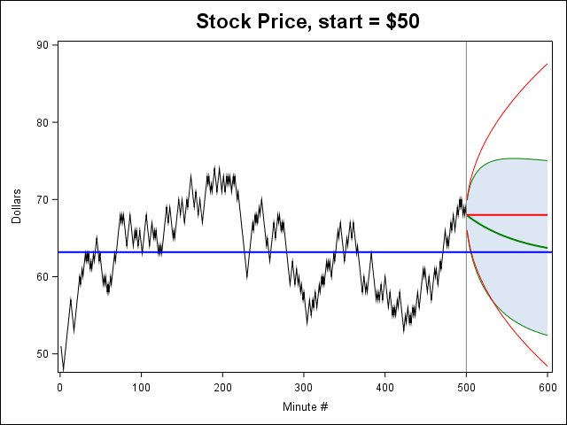
Two forecasts:
ρ estimated (0.9778)
ρ =1

Slide 8
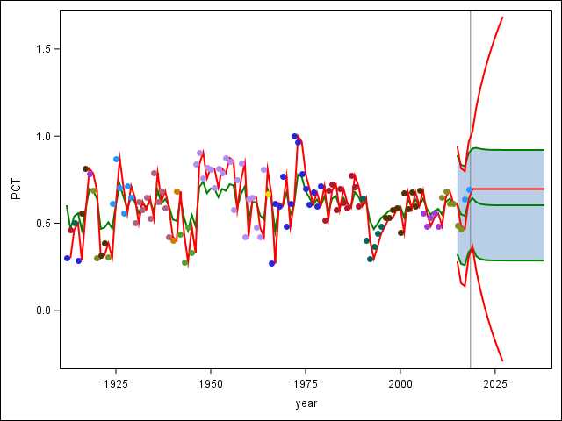
Winning
Percentages
Random Walk (ρ=1) and AR(1) (ρ=0.4464)

Slide 9

Where are my clothes?
H₀:ρ=1 H₁:|ρ|<1
?

Slide 10

Basic Model, f(t) = μ
Y_{t}−μ = ρ(Y_{t-1}−μ)+e_{t}
−(Y_{t-1}−μ) − (Y_{t-1}−μ)
Y_{t}−Y_{t-1} = (ρ−1)(Y_{t-1}−μ) + e_{t}
H₀: ρ−1=0
Regress on 1, Y_{t-1}
t-stat

Slide 11

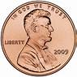
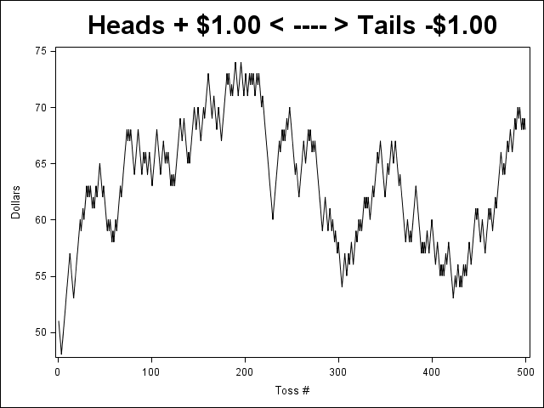


Basic Model:
Y_{t}− f(t) = ρ(Y_{t-1}− f(t−1))+e_{t}
Y_{t}− μ = ρ(Y_{t-1} − μ)+e_{t}
H₀:ρ=1
Y_{t}-μ = Y_{t-1}- μ + e_{t}
then Y_{t}= Y_{t-1}+e_{t} (random walk)
+ $1
- $1

Slide 12
Parameter Estimates
Parameter Standard
Variable DF Estimate Error t Value Pr > |t|
Intercept 1 0.32618 0.11908 2.74 0.0064
Lsum 1 -0.02219 0.00839 -2.64 0.0084
Reject H₀: ρ=1
But we KNOW that ρ=1 ????

Slide 13



Testing a
hypothesis
H₀:
H₁:
H₀: Innocence
H₁: Guilt
Beyond reasonable doubt
P<0.05
H₀: ρ=1
(random walk)
H₁: |ρ|<1
(stationary)
Truth: random walk. Conclusion: (p=0.0084) -> stationary
(not “stationary”)
Mistrial?

Slide 14
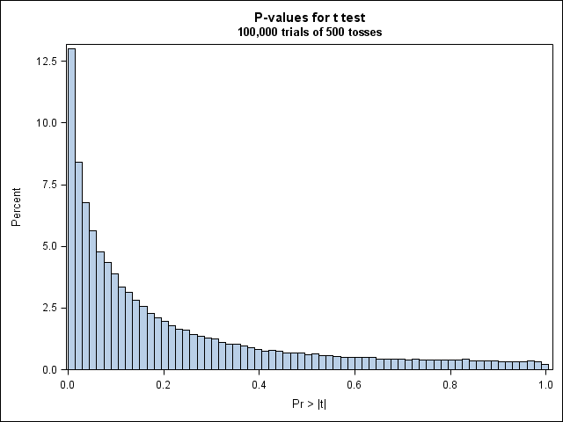


100,000 coin flip trials
of 500 tosses each
Reject H₀: ρ=1 in 30%
But we KNOW that ρ=1
(nominal α=0.05)
100,000 p-values ◊
0
1

Slide 15


What’s Wrong?
Y_{t}− μ = ρ(Y_{t-1}− μ)+e_{t}
Y_{t}= μ(1− ρ) + ρY_{t-1}+e_{t}
Y_{t}= β₀ + β₁Y_{t-1}+e_{t}
Linear model − yes!
e_{t} ~ (0,σ²) independently – yes!
Regressors fixed and known

Slide 16


“I confess that in 1901
I said to my brother
Orville that man would
not fly for fifty years.”
(first flight Dec. 1903)
Wilbur
Wright
Lesson 1:
Jim Valvano NCSU basketball coach

Slide 17
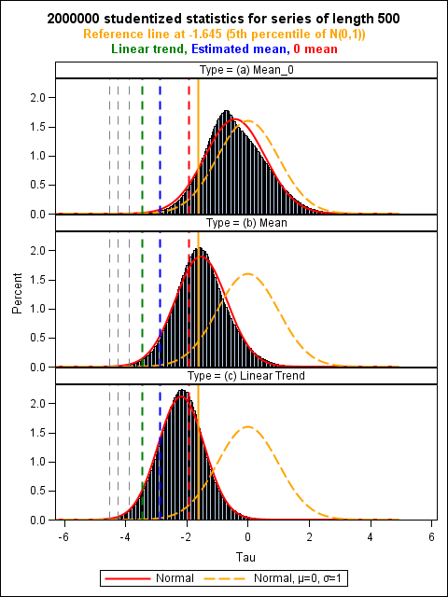
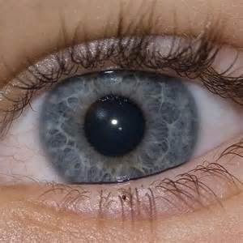
Let’s
Take
A Look
f(t)
Mean=0
←
Mean
Estimated
←
Linear
Trend
←

Slide 18
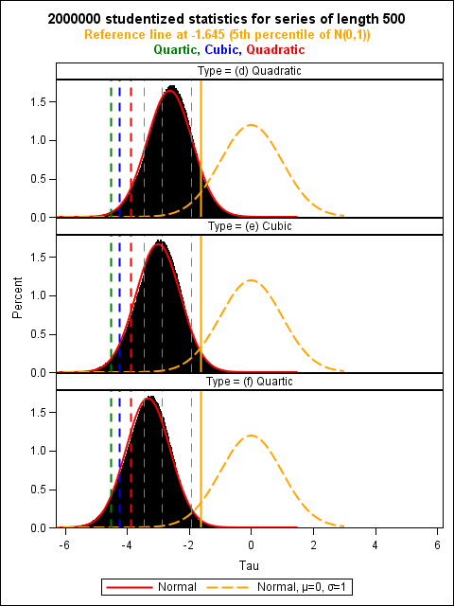
Let’s
Take
A Look
f(t)
Quadratic
←
Cubic
←
Quartic
←

Slide 19
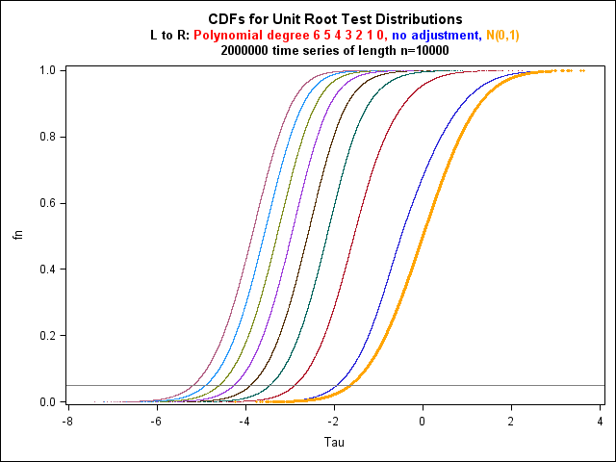

Slide 20
Lesson 2: Check your assumptions
COIN TOSS
Parameter Standard
Variable DF Estimate Error t Value Pr>|t|
Intercept 1 0.32618 0.11908 2.74 0.0064
Lsum 1 -0.02219 0.00839 -2.64 0.0084 ??
=============================================================
5% Critical values
Quartic Cubic Quadratic Linear Mean 0
-4.53 -4.21 -3.84 -3.41 -2.86 -1.95
| -2.64=τμ
←reject unit roots | don’t reject →
|
| True Pr{t<-2.64}
| exceeds 0.05

Slide 21
Commercial Products include SASTM and others
PROC ARIMA Data=cointoss;
Identify var=sum stationarity=(Dickey=(0));
Dickey-Fuller Unit Root Tests
Type Lags Rho Pr<Rho Tau Pr<Tau
Zero Mean 0 -0.4367 0.5838 -0.28 0.5861
Single Mean 0 -11.0708 0.1030 -2.64 0.0852 !!
Trend 0 -11.8969 0.3173 -2.80 0.1996
TM SAS is the registered trademark of SAS Institute Cary NC

Slide 22


Mathematical Results:
Regress Y_{t} − Y_{t-1} on Y_{t-1}
where Y_{t} = 1Y_{t-1} + e_{t}
B(t): Brownian Motion on [0,1]
Z_{i} ~ N(0,1), independently
WARNING:
Algebra like this has been known to cause headache, nausea,
and lack of sleep, especially in MSA students.

Slide 23

Interesting formula!
Got more?

Slide 24
Part 2, the studentized test statistic (τ)
Regress Y_{t} − Y_{t-1} on Y_{t-1}
Y_{t} = 1Y_{t-1} + e_{t}
Mathematical Results:

Slide 25

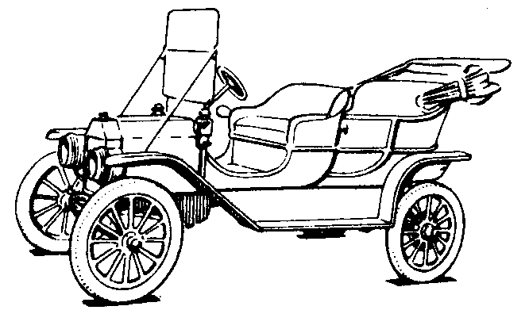
Lesson 2:
Attitude matters
Whether you think you can, or you think you can't--you're right.
Henry Ford

Slide 26
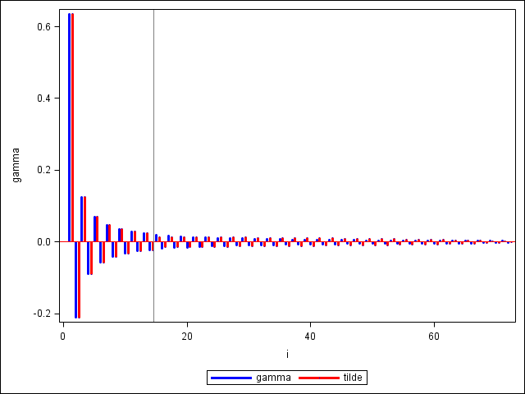
Numerator:
Denominator:
Lesson 3 :
Knowing a little
math can help

Slide 27

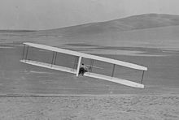
Winning idea:
(1) Large simulations for finite sample size
(2) Simulate from limit approximation
Jimmy V
@NCSU
Wright glider Oct. 24, 1902

Slide 28


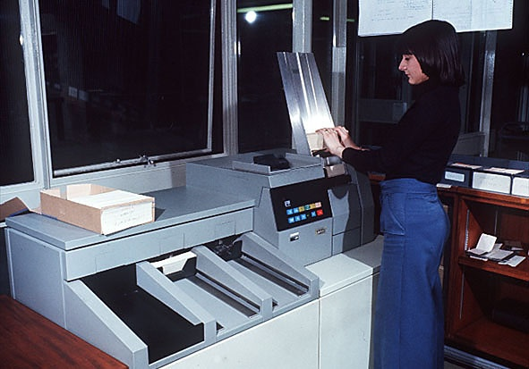
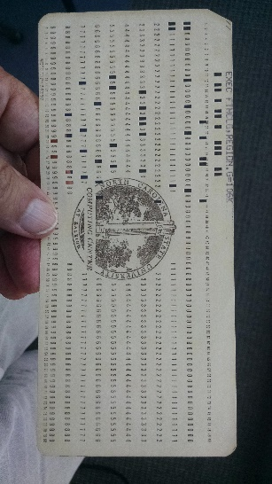
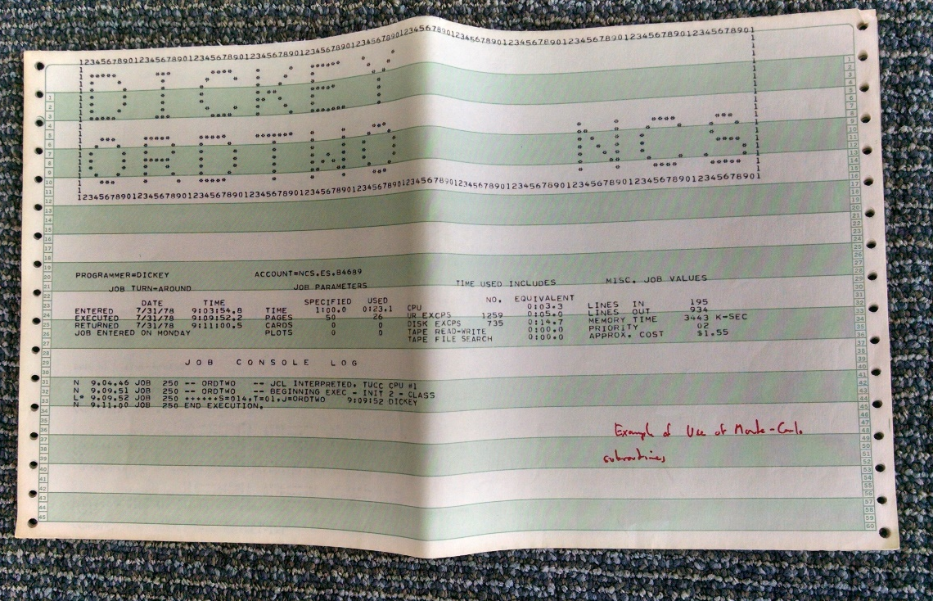
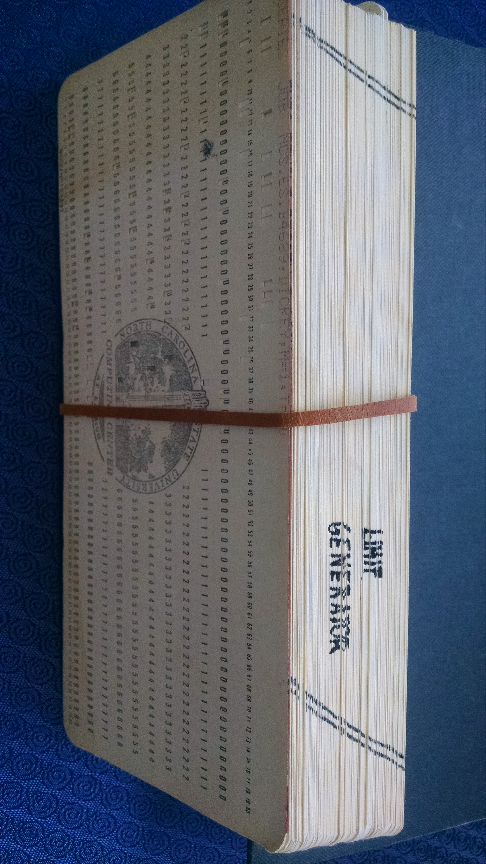

Slide 29
n P1 P5 P10 P25 P50 mean P75 P90 P95 P99
f(t)=0
25 -2.67 -1.96 -1.61 -1.07 -0.47 -0.40 0.25 0.93 1.34 2.14
50 -2.61 -1.94 -1.61 -1.08 -0.49 -0.41 0.23 0.91 1.31 2.08
100 -2.59 -1.94 -1.62 -1.09 -0.49 -0.42 0.23 0.90 1.30 2.04
250 -2.58 -1.94 -1.62 -1.09 -0.50 -0.42 0.22 0.89 1.29 2.02
500 -2.57 -1.94 -1.61 -1.09 -0.50 -0.42 0.22 0.89 1.29 2.02
1000 -2.57 -1.94 -1.62 -1.09 -0.50 -0.42 0.22 0.89 1.28 2.02
f(t)=μ
25 -3.74 -2.99 -2.64 -2.09 -1.53 -1.52 -0.96 -0.37 0.00 0.72
50 -3.57 -2.92 -2.60 -2.09 -1.55 -1.53 -0.99 -0.40 -0.04 0.66
100 -3.50 -2.89 -2.58 -2.09 -1.56 -1.53 -1.00 -0.42 -0.06 0.64
250 -3.46 -2.87 -2.57 -2.09 -1.56 -1.53 -1.01 -0.43 -0.07 0.61
500 -3.44 -2.87 -2.57 -2.09 -1.56 -1.53 -1.01 -0.44 -0.08 0.61
1000 -3.44 -2.87 -2.57 -2.09 -1.57 -1.53 -1.01 -0.44 -0.08 0.61
f(t)=α+βt
25 -4.40 -3.61 -3.24 -2.69 -2.14 -2.17 -1.63 -1.14 -0.82 -0.17
50 -4.16 -3.51 -3.18 -2.68 -2.16 -2.18 -1.67 -1.20 -0.88 -0.25
100 -4.05 -3.46 -3.15 -2.67 -2.17 -2.18 -1.69 -1.22 -0.91 -0.29
250 -4.00 -3.43 -3.14 -2.67 -2.18 -2.18 -1.70 -1.23 -0.93 -0.31
500 -3.98 -3.42 -3.13 -2.67 -2.18 -2.18 -1.70 -1.24 -0.94 -0.32
1000 -3.97 -3.41 -3.13 -2.67 -2.18 -2.18 -1.70 -1.24 -0.94 -0.32
(2 million runs each. n=1000 took < 3 min. in SAS)

Slide 30
Winning
Percentages
The ARIMA Procedure
Augmented Dickey-Fuller Unit Root Tests
Type Lags Tau Pr < Tau
Zero Mean 0 -1.21 0.2071
1 -0.90 0.3228
2 -0.58 0.4645
Single Mean 0 -6.52 <.0001
1 -5.64 <.0001
2 -4.32 0.0007
Trend 0 -6.49 <.0001
1 -5.61 <.0001
2 -4.30 0.0047
Reject
H0: Unit Root

Slide 31

Definition: Power
The probability of rejecting a null
hypothesis when you should (Pr{reject})
Modified Definition:
Parzen Power
Pr{reject}*Pr{use}
Dr. Emanuel Parzen, Distinguished Professor Emeritus of Statistics, Texas A&M University
(1929 – 2016)

Slide 32
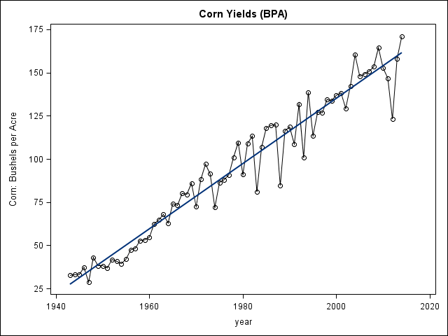
Basic Model 2: f(t) = α+βt
Y_{t}—(α+βt)= ρ(Y_{t-1}—(α+β(t-1)))+e_{t}
(1943 - 2014)

Slide 33

Y_{t}−(α+βt) = ρ(Y_{t-1}− (α+β(t-1)))+e_{t}
−(Y_{t-1}− (α+β(t-1))) −(Y_{t-1}− (α+β(t-1)))
Y_{t}−Y_{t-1} −β = (ρ−1)(Y_{t-1}− (α+βt−β)))+e_{t}
Y_{t}−Y_{t-1} = (β - (ρ−1)(α−β)) + (ρ−1)βt + (ρ−1)Y_{t-1}+e_{t}
β₀ β₁t
H₀: ρ−1=0
Regress Y_{t}−Y_{t-1} on 1, t, Y_{t-1}
t-stat

Slide 34
Y_{t}−(α+βt) = ρ(Y_{t-1}− (α+β(t-1)))+e_{t}
If H₀:ρ=1 is true then Y_{t}= Y_{t-1}+β+e_{t}
random walk with drift β

Slide 35

Corn yields, after 1942
Dickey-Fuller Unit Root Tests
Type Lags Rho Pr<Rho Tau Pr<Tau
Zero Mean 0 0.7047 0.8515 0.61 0.8454
Single Mean 0 -3.6170 0.5739 -1.23 0.6559
Trend 0 -74.8033 0.0002 -8.65 <.0001
Autocorrelation Check of Residuals
(from linear trend plus white noise)
To Chi- Pr >
Lag Square DF ChiSq -------------Autocorrelations------------
6 4.27 6 0.6403 -0.053 -0.042 -0.060 -0.022 0.204 -0.061
12 10.82 12 0.5445 -0.017 -0.087 -0.053 0.126 -0.205 -0.083
18 15.54 18 0.6247 0.029 0.020 -0.019 -0.200 0.041 -0.079
24 22.43 24 0.5535 0.188 -0.076 -0.109 0.006 0.076 0.090
Lesson 4: Just because a series is trending up does not mean you need to difference!

Slide 36

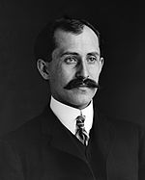
Lesson 4: Just because a series is trending up
does not mean you need to difference!
Powered flight
Kill Devil Hills NC, Dec. 1903
If we all worked on the assumption that what is accepted as true is really true, there would be little hope of advance. (Orville Wright)

Slide 37
Corn yields, before 1943
Dickey-Fuller Unit Root Tests
Type Lags Rho Pr < Rho Tau Pr<Tau
Zero Mean 0 -0.4836 0.5712 -0.35 0.5569
Single Mean 0 -67.4004 0.0007 -7.26 0.0001
Trend 0 -67.4900 0.0002 -7.23 <.0001
Maximum Likelihood Estimation
Standard Approx
Parameter Estimate Error t Value Pr > |t|
MU 26.17532 0.36683 71.35 <.0001
Autocorrelation Check of Residuals
To Chi- Pr >
Lag Square DF ChiSq -------------Autocorrelations------------
6 3.25 6 0.7764 0.100 0.070 0.034 0.029 -0.111 -0.098
12 7.07 12 0.8532 0.037 -0.111 -0.096 -0.067 -0.103 -0.064
18 8.76 18 0.9651 -0.033 0.014 -0.049 -0.018 0.102 -0.048
24 14.92 24 0.9232 -0.019 0.120 0.105 -0.134 0.041 -0.103

Slide 38
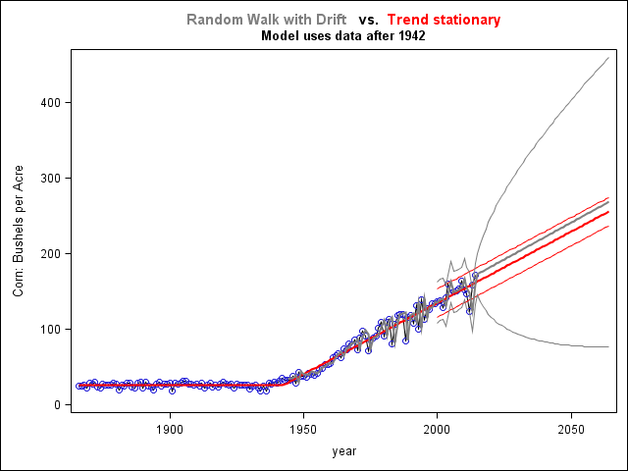



Slide 40
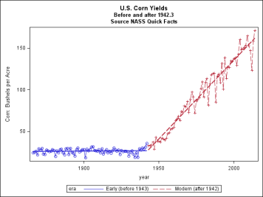
Corn yields, full data set, OLS
2014
1866
OLS
Parameter Standard
Variable DF Estimate Error t Value Pr>|t|
Intercept 1 -214.19228 73.80743 -2.90 0.0043
L_corn 1 -0.10437 0.03840 -2.72 0.0074
year 1 0.11403 0.03904 2.92 0.0040
Dickey-Fuller Unit Root Tests
Type Lags Rho Pr < Rho Tau Pr < Tau
Zero Mean 0 1.2872 0.9481 0.76 0.8777
Single Mean 0 -0.9267 0.8916 -0.33 0.9167
Trend 0 -15.4471 0.1562 -2.72 0.2309

Slide 41

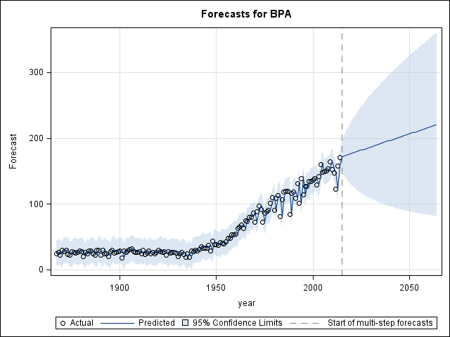
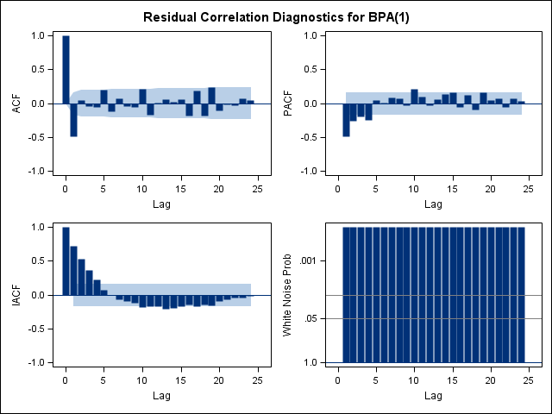
hybrid corn, introduced in
the early 20th century
2) genetics
3) pesticides and fertilizers.
Random Walk with Drift
Lesson 5: Always, always, always
plot the data first.

Slide 42
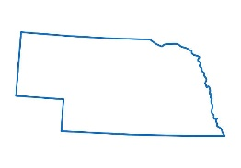

Following up – What about rainfall?
Post 1942 corn yields (R-square 95%)
Parameter Estimates
Parameter Standard
Variable DF Estimate Error t Value Pr >|t| Type I SS
Intercept 1 -3629.76791 103.57825 -35.04 <.0001 643035
year 1 1.87381 0.05261 35.62 <.0001 110899
inches 1 0.73735 0.29050 2.54 0.0134 548
(no residual autocorrelation detected )
Lesson 6: A little common sense helps too!

Slide 43
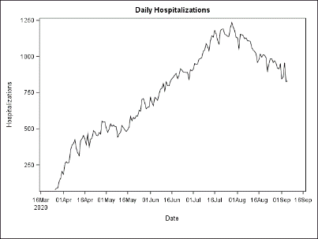

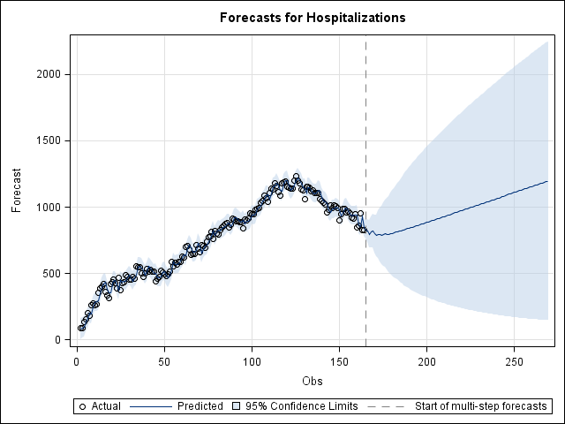
proc arima data=covid plots=forecast(forecast);
identify var=hospitalizations(1);
estimate p=(1)(7) q=(6 8) ml;
forecast lead=105; run;
Autocorrelation Check of Residuals
To Chi- Pr >
Lag Sq DF ChiSq
6 4.72 2 0.0943
12 5.96 8 0.6518
18 14.32 14 0.4339
24 23.83 20 0.2500
30 30.25 26 0.2574

Slide 44
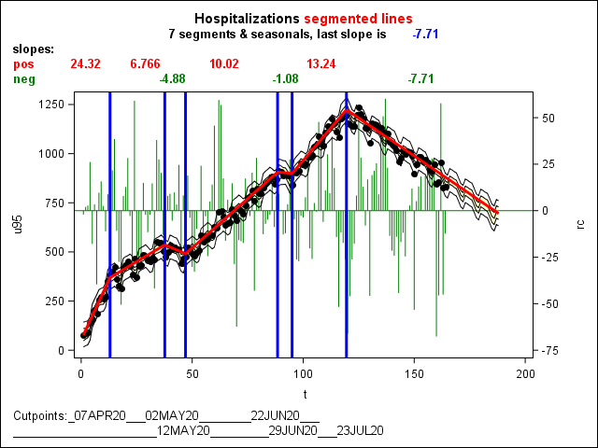

Slide 45
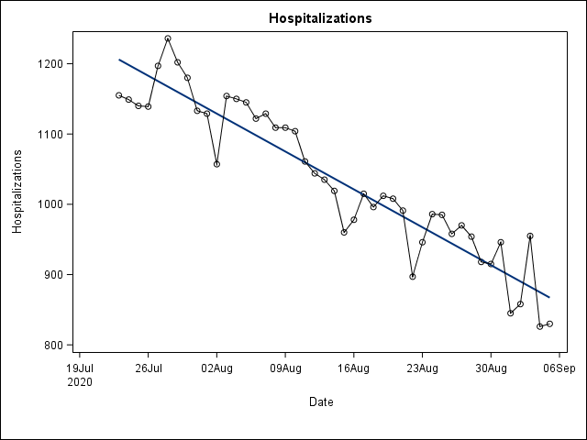
proc reg data=Lastpart;
model D = t fri sat sun LH; run;
Variable Estimate t Val Pr>|t|
Int 1698.09468 5.69 <.0001
t -6.17379 -5.55 <.0001
Fri -29.96765 -2.18 0.0354
Sat -47.59255 -3.45 0.0014
Sun -35.86076 -2.33 0.0253
LH -0.77049 -5.63 <.0001 ←--
0.0002
estimate input = (date sat sun) p=1 ml;
Autocorrelation Check
of Residuals
To Chi- Pr >
Lag Square DF ChiSq
6 2.52 5 0.7734
12 5.44 11 0.9082
18 8.61 17 0.9517
24 14.82 23 0.9009
Parmtr Estimate t Pr>|t|
MU 170245.8 14.03 <.0001
AR1,1 0.31626 2.05 0.0405
DATE -7.64189 -13.95 <.0001
SAT -37.11140 -2.66 0.0079
SUN -37.98612 -2.62 0.0089

Slide 46
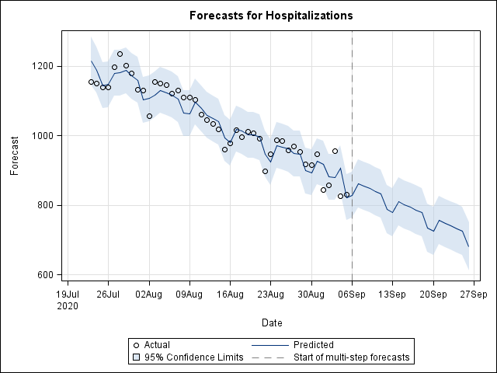

Slide 47
Higher Order Models
stationary:
“characteristic eqn.”
roots 0.5, 0.8 ( < 1)
note: −(1-.5)(1-.8) = −0.1
nonstationary
Exit

Slide 48
Tests
Regress:
These coefficients → normal!
| ← → |
on (1, t)
Y_{t-1}
( augmenting terms )
ρ-1
( τ )
augmenting affects limit distn.
“ does not affect “ “
Exit

Slide 49
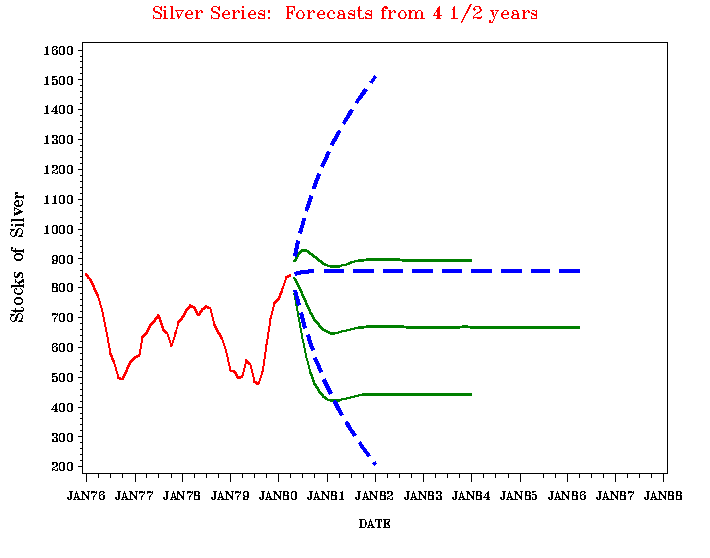
Nonstationary Forecast
Stationary Forecast

Slide 50
Is AR(2) sufficient ? test vs. AR(5).
proc reg; model D = Y1 D1-D4; test D2=0, D3=0, D4=0;
Source df Coeff. t Pr>|t|
Intercept 1 121.03 3.09 0.0035
Y_{t-1} 1 -0.188 -3.07 0.0038
Y_{t-1}-Y_{t-2} 1 0.639 4.59 0.0001
Y_{t-2}-Y_{t-3} 1 0.050 0.30 0.7691
Y_{t-3}-Y_{t-4} 1 0.000 0.00 0.9985
Y_{t-4}-Y_{t-5} 1 0.263 1.72 0.0924
F₄₁³ = 1152 / 871 = 1.32 Pr>F = 0.2803
X

Slide 51
Fit AR(2) and do unit root test
Method 1: OLS output and tabled critical value (-2.86)
proc reg; model D = Y1 D1;
Source df Coeff. t Pr>|t|
Intercept 1 75.581 2.762 0.0082 X
Y_{t-1} 1 -0.117 -2.776 0.0038 X
Y_{t-1}-Y_{t-2} 1 0.671 6.211 0.0001 ☺
Method 2: OLS output and corrected p-values
proc arima; identify var=silver stationarity = (adf=(1));
Augmented Dickey-Fuller Unit Root Tests
Type Lags t Prob<t
Zero Mean 1 -0.2803 0.5800
Single Mean 1 -2.7757 0.0689 ☺
Trend 1 -2.6294 0.2697

Slide 52
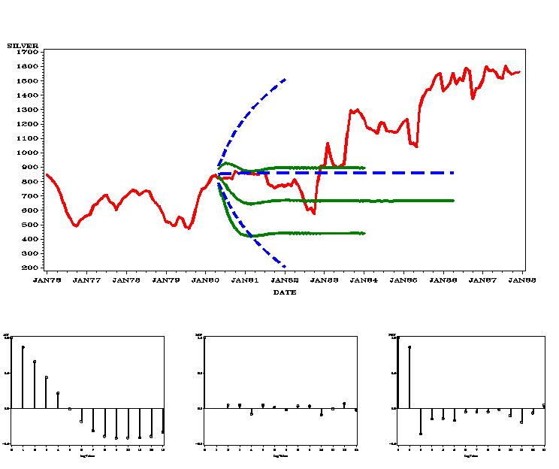
Silver Series – the rest of the story!
?
First part ACF IACF PACF

Slide 53
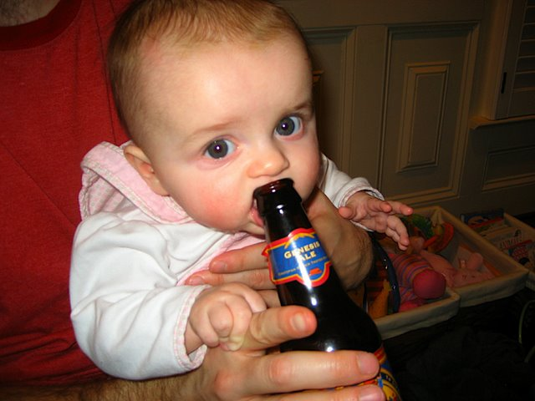
Your talk seems better now Grandpa!
Disclaimer: No babies ingested alcohol in the making of this slide.
(I personally made sure the bottle was empty).
Exit

Slide 54
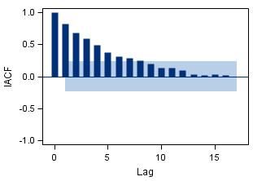
Detecting overdifferencing
Generated Data →
Differences →
(“Non-invertible moving average”)
Chang (1993) Moving average unit root (e.g. θ=1) →
slow decay in IACF (Inverse AutoCorrelation Function)
Inverse Autocorrelations →
(of differences)
Chang, M. C., Dickey, D. A. , (1993) "Recognizing Overdifferenced Time Series," Journal of Time Series Analysis , 15, 1-8.

Slide 55
Y_{t}-μ = ρ(Y_{t-1}-μ) + e_{t} – θe_{t-1}
Autoregressive Moving Average
Model (|θ|<1)
Inverse Autocorrelation Function (IACF) is autocorrelation function of
Y_{t}-μ = θ(Y_{t-1}-μ) + e_{t} –ρe_{t-1}
(2) Said E. Said*: With sufficient data and lagged differences, just treat this
as autoregressive to test H₀: ρ=1.
* Said S.E. and Dickey, D. A. (1984). "Testing for Unit Roots in Autoregressive-Moving Average Models of Unknown Order," Biometrika 71, 599-607.

Slide 56
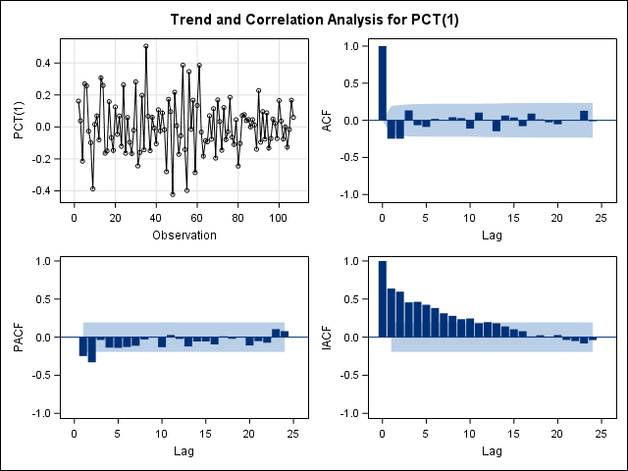
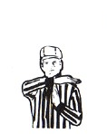
Winning
Percentages
Differences
(differenced)
IACF

Slide 57

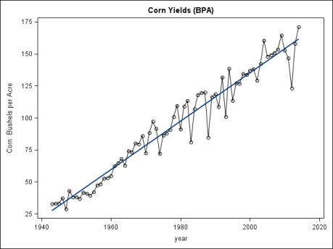
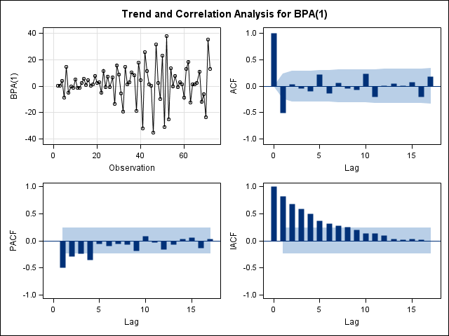

Post 1942
Corn Yields
(differenced)
IACF
58

Slide 58

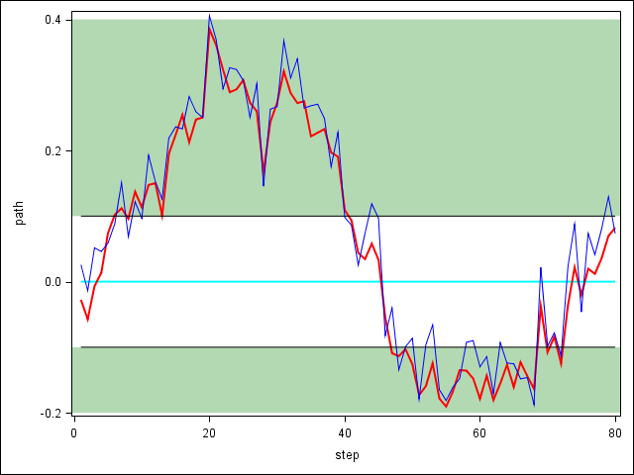
(Time permitting)
Cointegration analogy:
Drunk man walking a dog
Man -> unit root process
Dog-> unit root process
Difference (man-dog) stationary!
58
Dog – blue path
Man – red path
Sidewalk
Exit

Slide 59
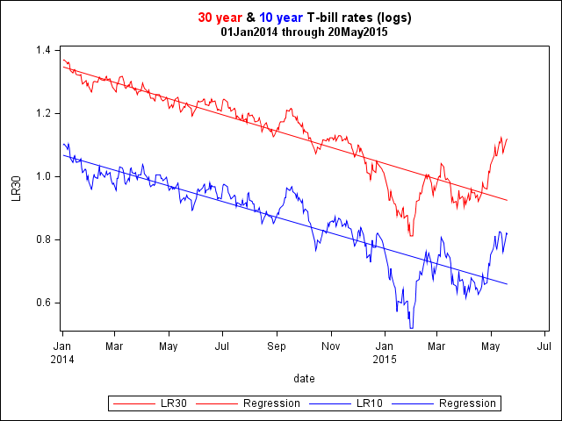
Data:
10 year t-bill yields
30 year t-bill yields
(in logarithms)

Slide 60
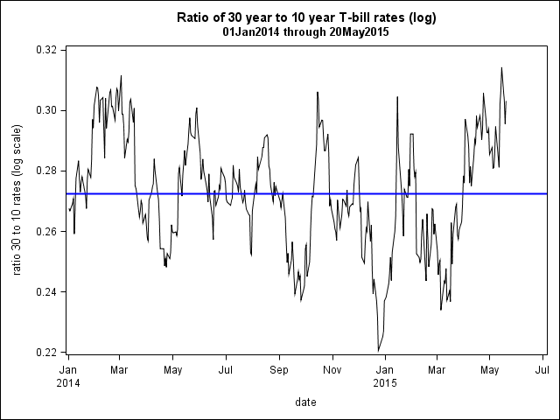
Log of Ratio
30 year t-bill yields
10 year t-bill yields
Log of
= log(30 yr.)-log(10 yr.)

Slide 61
Check #1 both series are unit root types - yes
(10 year t-bills)
Augmented Dickey-Fuller Unit Root Tests
Type Lags Rho Pr < Rho Tau Pr < Tau
Zero Mean 0 -0.4461 0.5815 -1.05 0.2635
1 -0.4438 0.5820 -1.09 0.2491
2 -0.4283 0.5854 -1.07 0.2573
Single Mean 0 -5.4449 0.3922 -1.96 0.3065
1 -5.2415 0.4106 -1.95 0.3106
2 -5.0587 0.4278 -1.89 0.3351
Trend 0 -16.6981 0.1292 -2.63 0.2652
1 -15.9949 0.1482 -2.51 0.3207
2 -16.1441 0.1440 -2.47 0.3421
Can’t
Reject
Unit Root
(30 year t-bills)
Augmented Dickey-Fuller Unit Root Tests
Type Lags Rho Pr < Rho Tau Pr < Tau
Zero Mean 0 -0.2652 0.6222 -1.09 0.2487
1 -0.2662 0.6220 -1.13 0.2346
2 -0.2595 0.6235 -1.08 0.2525
Single Mean 0 -3.5711 0.5870 -1.74 0.4082
1 -3.5006 0.5953 -1.76 0.4013
2 -3.5035 0.5950 -1.72 0.4194
Trend 0 -6.1699 0.7287 -1.24 0.9002
1 -5.5451 0.7783 -1.12 0.9231
2 -6.0531 0.7381 -1.17 0.9140
Can’t
Reject
Unit Root

Slide 62
Check #2 Need more than one difference? – no
Tests on differenced data:
(10 year t-bills)
Augmented Dickey-Fuller Unit Root Tests
Type Lags Rho Pr < Rho Tau Pr < Tau
Zero Mean 0 -359.430 0.0001 -19.34 <.0001
1 -369.931 0.0001 -13.56 <.0001
2 -321.229 0.0001 -10.38 <.0001
Single Mean 0 -360.041 0.0001 -19.35 <.0001
1 -371.989 0.0001 -13.57 <.0001
2 -324.886 0.0001 -10.39 <.0001
Trend 0 -360.919 0.0001 -19.37 <.0001
1 -374.663 0.0001 -13.60 <.0001
2 -328.854 0.0001 -10.43 <.0001
Reject
Unit roots in
differenced
data
(30 year t-bills)
Augmented Dickey-Fuller Unit Root Tests
Type Lags Rho Pr < Rho Tau Pr < Tau
Zero Mean 0 -355.741 0.0001 -19.13 <.0001
1 -342.063 0.0001 -13.04 <.0001
2 -288.960 0.0001 -10.00 <.0001
Single Mean 0 -356.585 0.0001 -19.15 <.0001
1 -344.588 0.0001 -13.06 <.0001
2 -293.062 0.0001 -10.02 <.0001
Trend 0 -358.485 0.0001 -19.23 <.0001
1 -350.087 0.0001 -13.15 <.0001
2 -301.163 0.0001 -10.11 <.0001
Reject
Unit roots in
differenced
data

Slide 63
Two unit root processes X_{t} and Y_{t} are cointegrated if some
linear combination (aX_{t} +bY_{t}, e.g. 1X_{t} -1Y_{t}) is stationary.
We have 2 unit root processes
Are they “cointegrated?”
Can we use a = 1 and b = -1 ?
Is log(30 yr. rate) – log(10 yr. rate)
( = log(30 yr. rate/10 yr. rate)) stationary?
Augmented Dickey-Fuller Unit Root Tests
Type Lags Rho Pr < Rho Tau Pr < Tau
Zero Mean 0 0.0028 0.6832 0.01 0.6844
1 0.0243 0.6882 0.05 0.6991
2 0.0324 0.6900 0.07 0.7060
3 0.0204 0.6872 0.04 0.6970
Single Mean 0 -27.6337 0.0017 -3.69 0.0048
1 -24.9002 0.0033 -3.42 0.0113
2 -22.8252 0.0054 -3.19 0.0216
3 -26.3394 0.0024 -3.36 0.0136
Trend 0 -28.5986 0.0100 -3.71 0.0227
1 -25.8595 0.0186 -3.44 0.0486
2 -23.7128 0.0298 -3.20 0.0866
3 -27.6531 0.0124 -3.37 0.0574
Decision: Series are cointegrated!

Slide 64
Which row of the table should we have used?
How many lagged differences do we need?
Regresss
usual distributions (normal, t, F)
H₀: No lagged differences needed
Conclusion: Can use top (0 lagged differences) row
Single Mean 0 -27.6337 0.0017 -3.69 0.0048

Slide 65

Final model:
log(30 yr. rate/10 yr. rate) is stationary with
estimated mean 0.2805 and autoregressive
order 1 structure with ρ=0.92
The full cointegration story:
How do we know that the stationary combination of Y_{t} and X_{t} is S_{t} = 1(Y_{t}) -1(X_{t})
rather than S_{t} = 2(Y_{t}) -7(X_{t}) or something else?
Estimate a and b in S_{t} = a(Y_{t}) +b(X_{t})
Find the effect on the unit root test of estimating a,b
Solution: Engle and Granger (and others)
Result: Nobel Prize in Economics (2003)

Slide 66


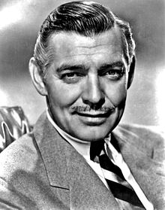
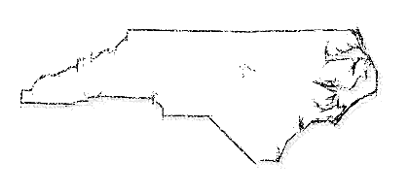
One Final Wilbur Wright Quote:
“If I were giving a young man advice as to how he might succeed in life, I would say to him, pick out a good father and mother, and begin life in Ohio.”
--Wilbur Wright, 1910
Wrights (& me) → *
… and one from Clark Gable:
“I'm just a lucky slob from Ohio who happened to be in the right place at the right time.”

Slide 67
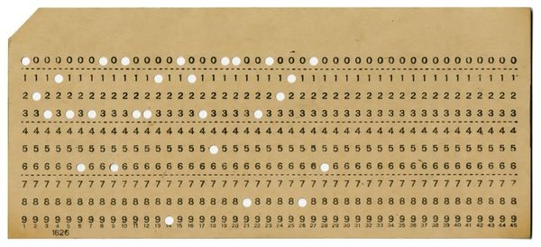


// * END OF FILE NCS.ES.B4689,DICKEY //
D. A. Dickey
ρ=1
Lesson 8: Don’t take yourself too seriously

